Slide 1
My Sql database Create Data Lab
Victor Patterson Sr.

Slide 2
Sql Structured query Language its sorta a love language talk to data base create update delte etc. Data base stores large amt of data think of this like a spread sheet with coloums and in DBMS data base mngt system

Slide 3
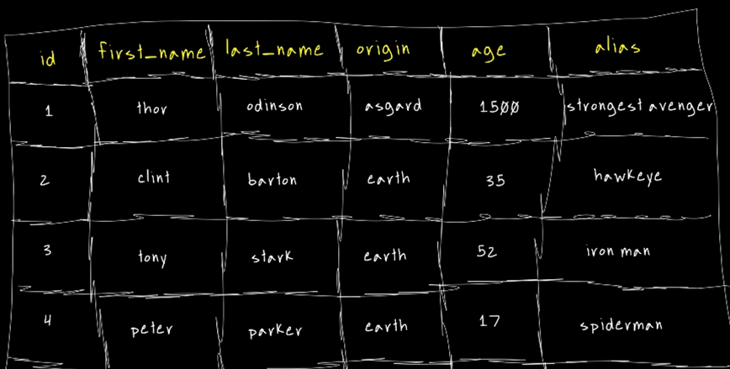
Data Base Types
1st Is Relational Data B
A way to understand is that you would have a related database
2nd the Non – relational Data is an unstructured database with use cases.

Slide 4
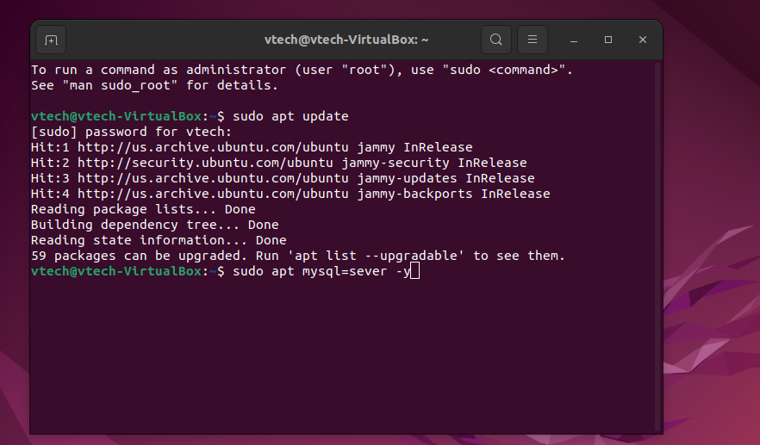
1st Step by step I launched my VM Oracle Linux machine ubuntu mint
Open your Terminal and command sudo apt update
Repository update as show
Sudo apt update as shown

Slide 5
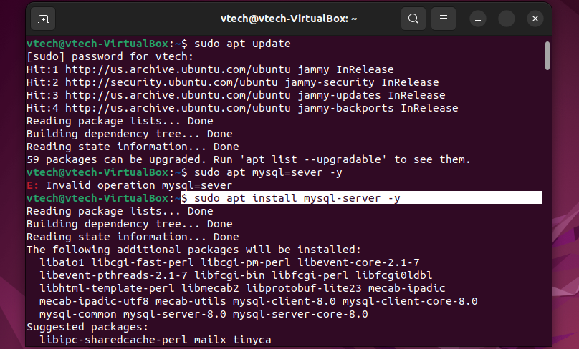
My sql Creations
Next in your Terminal
type
sudo apt install mysql-server –y (-y)= means tick

Slide 6
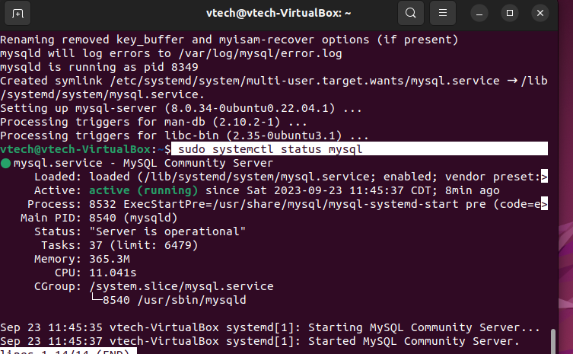
Check the status of mysql
Checked status by command sudo system ctl

Slide 7
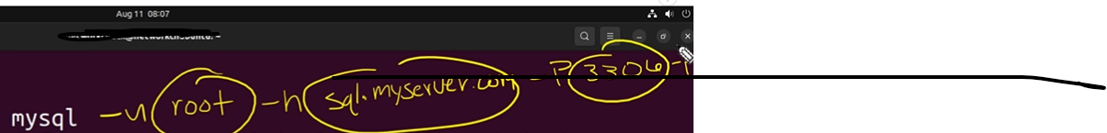
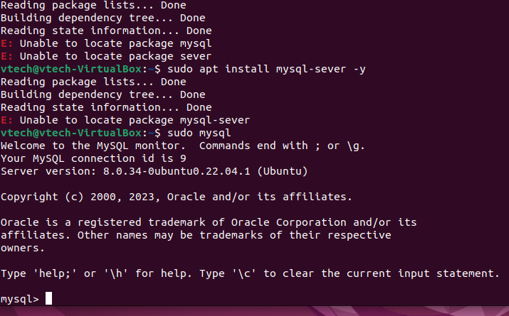
MySQL Should be running like this however this works b/c I am connected to my local host w/t no password as shown below in the near future, often you may see -u root for *user name* – sql.myserver.com *would be the remote server you would want to connect to* the - P 3306 is the Port number -p

Slide 8
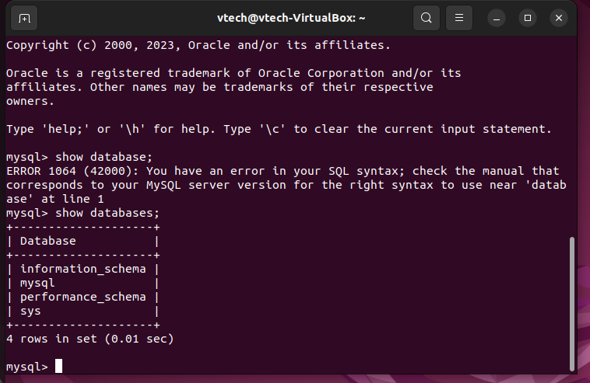
Next I checked current data bases
Command- show databases; side note anytime you use request a command you have to use a (;) and at the end of your command.

Slide 9
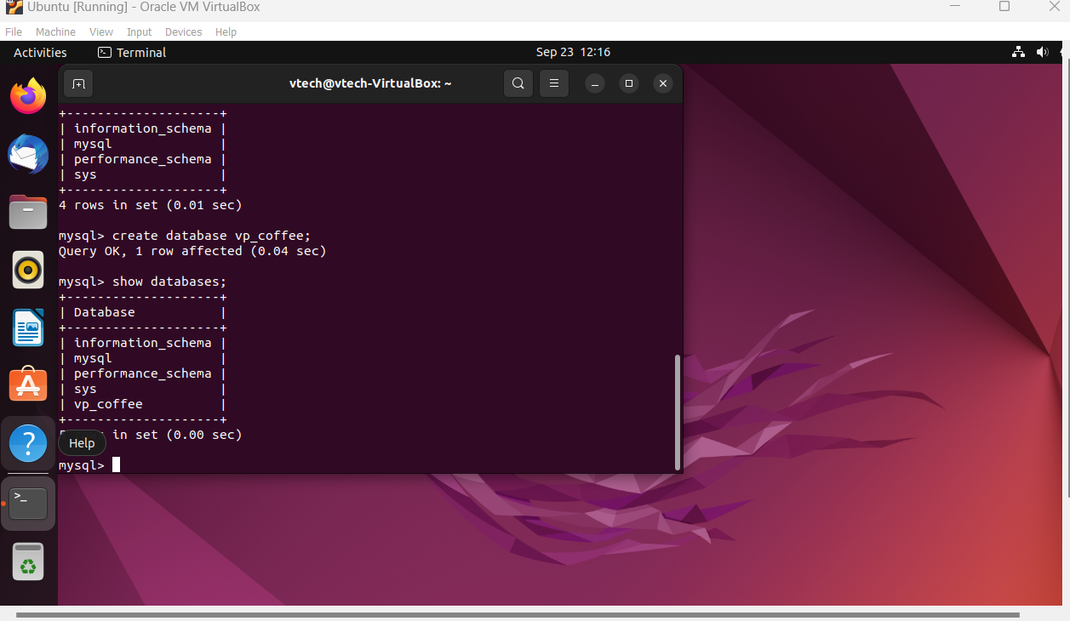
Created my own data base
I started my command create database vp_coffee;

Slide 10
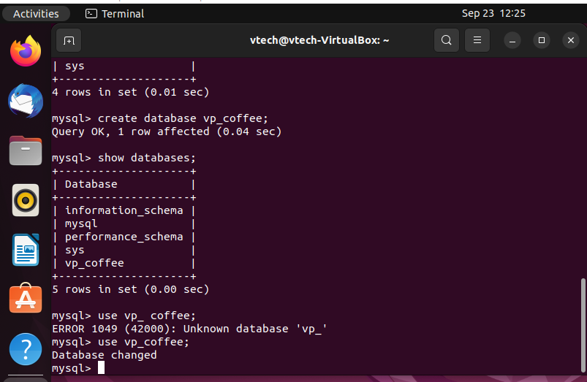
To use this current data base and interact with this data base
I used in mysql use vp_coffee;

Slide 11
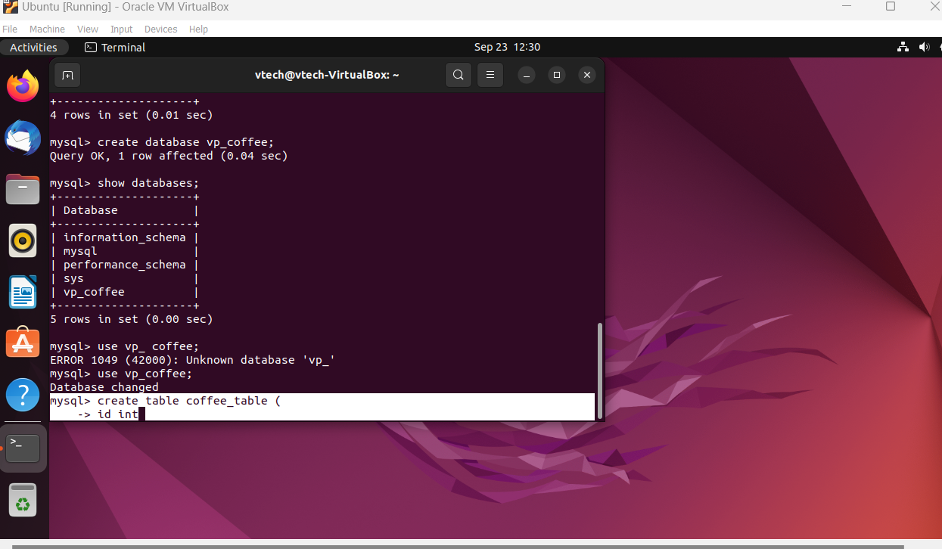
Mysql data base
What I did was created table in mysql by typing create table coffee_table(
Side note ( open parenthesis means your not finished with your command. My example shows this. ; means your done w/t that cmd.

Slide 12
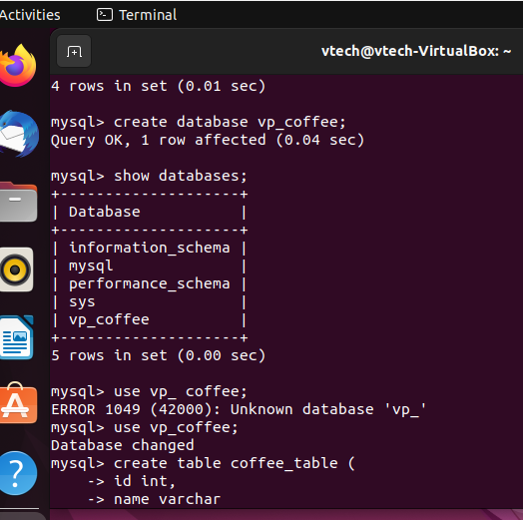
Defining the columns
I defined my columns by id int which defining the name of id in the name. The int defines what type of data is going to be in that column.
I also added a *name* called *varchar* which is end determinant length string data type.

Slide 13
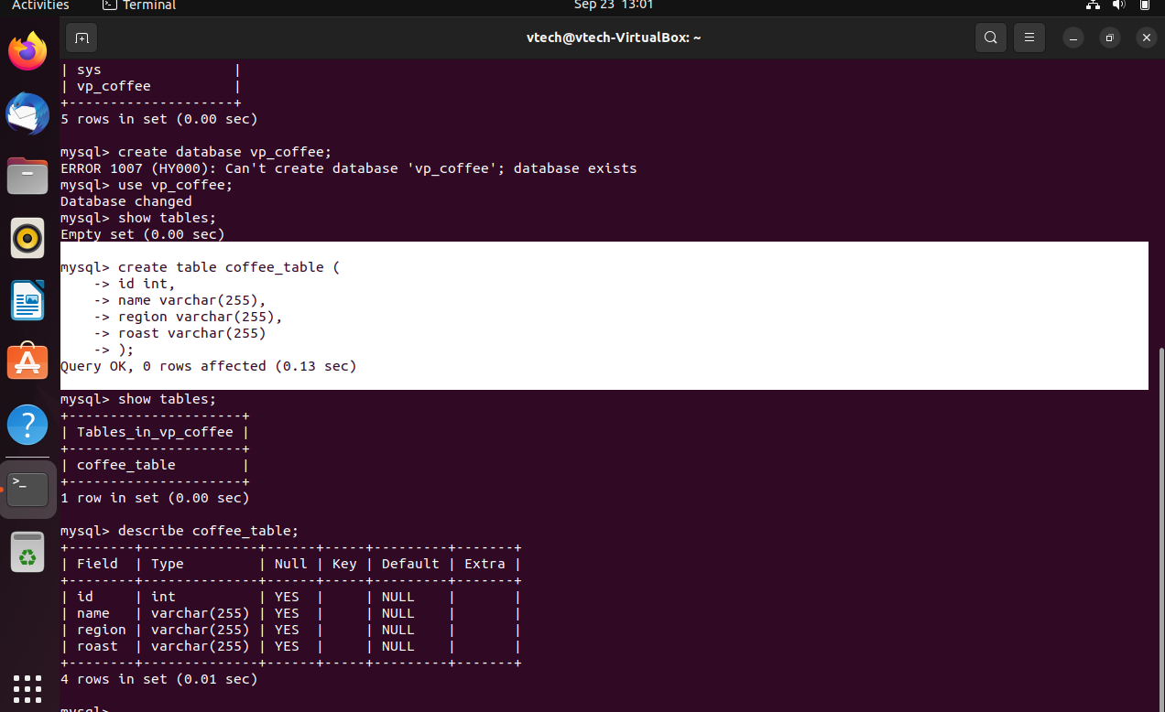
Continuing
Next I defined how long I wanted my characters to be allowed. I chose 255 *sidenote* varchar =variable characters

Slide 14
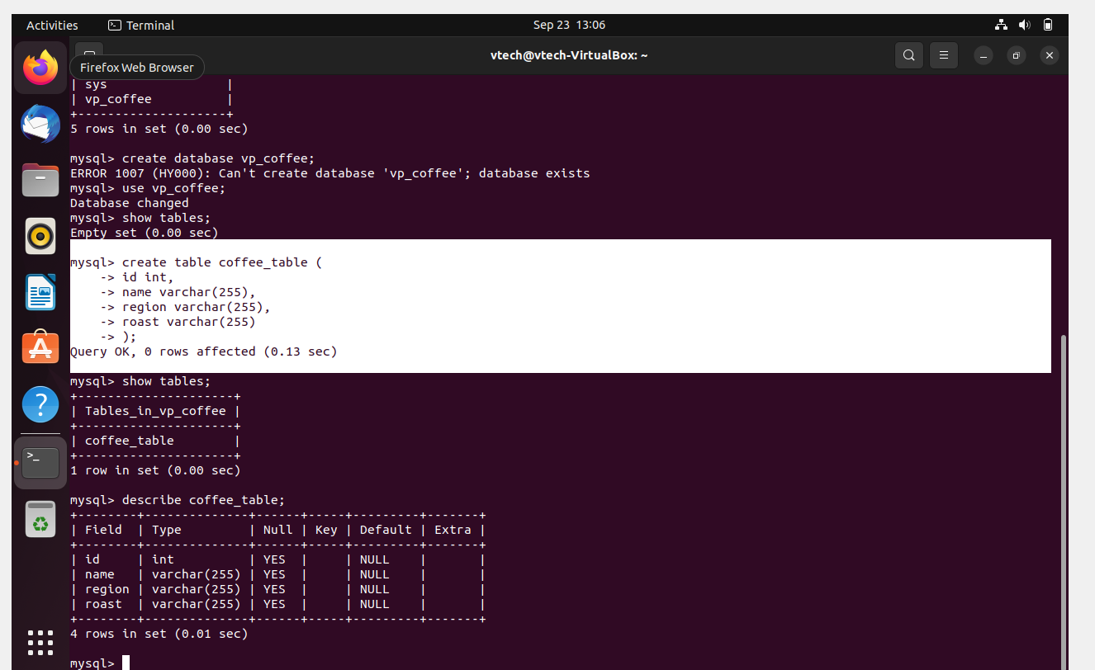
To check your table
Next I checked my table by typing *show tables;* but I also wanted to see my columns so I asked after verifying to describe coffee tables by asking to describe *coffee_table;*

Slide 15
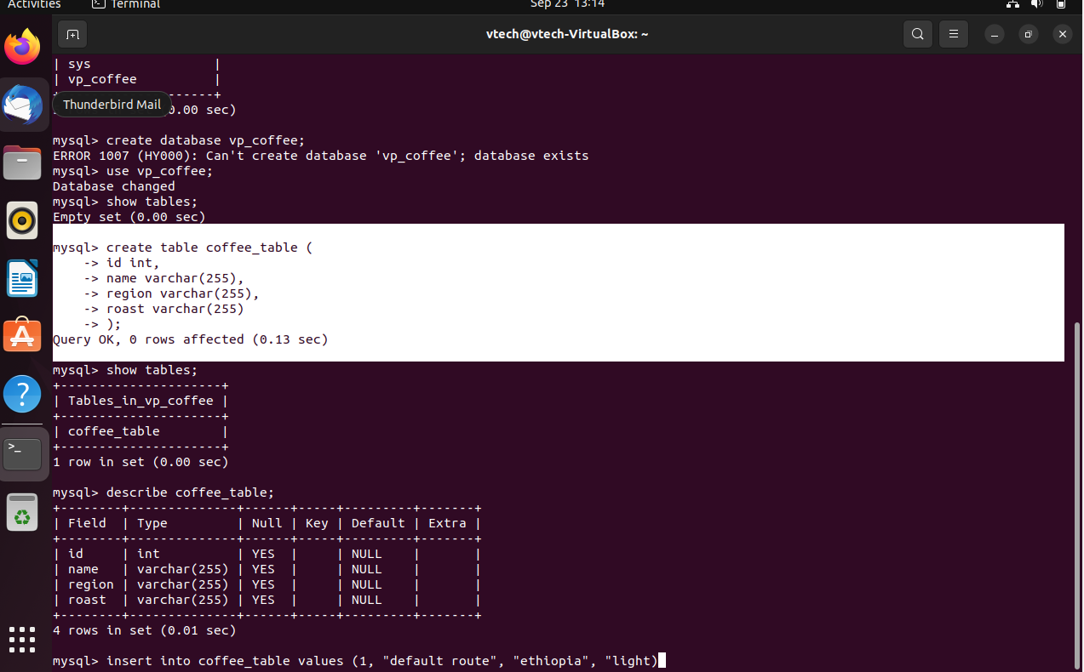
Continuation
Next in my table im telling mysql we’re inserting values into the coffee table. I have the ID the name, the region and the the roast

Slide 16
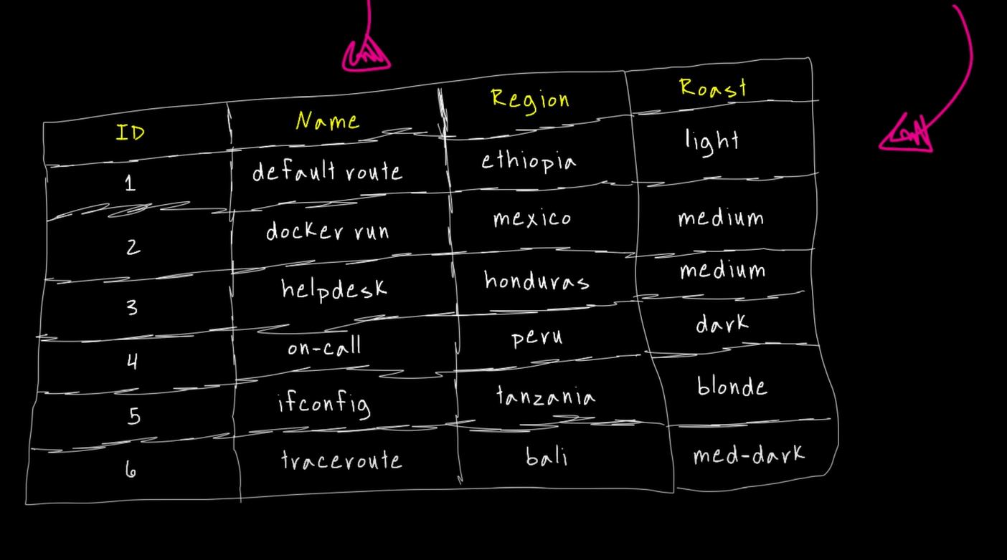
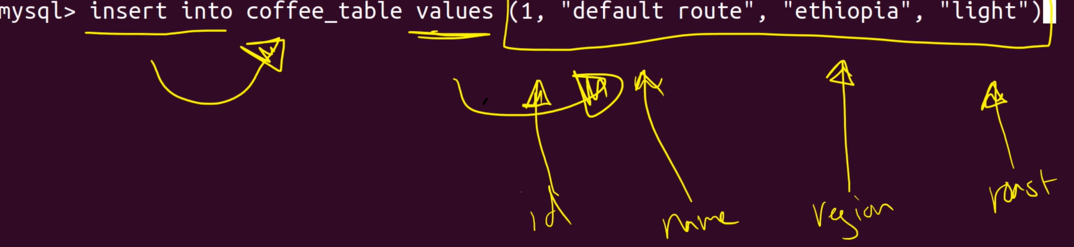
Adding more data to my database
In Order to have this hear is the values.
Command insert into coffee_table values (1, “default route, “Ethiopia”, “light”)

Slide 17
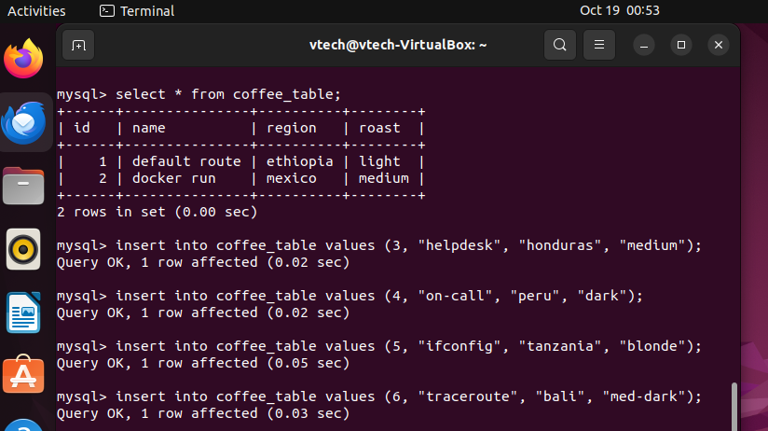
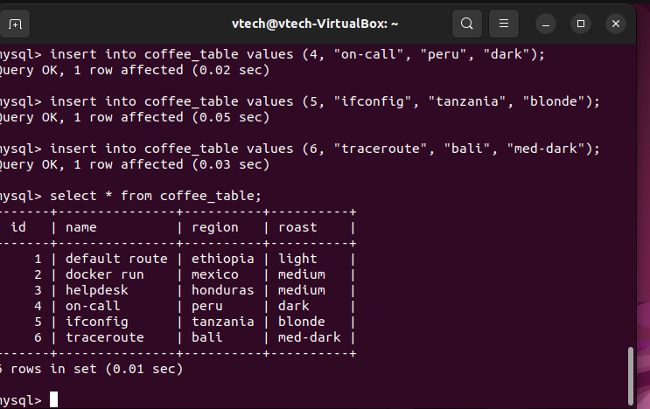
Adding tables
In continuations you I simply added rows by this cmd as showed. Your query should show ok if you perform your command correctly by it saying Query OK. I simply created a table inside the database and added some data to it.

Slide 18
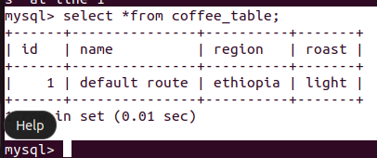
Interacting with my database pulling some data I typed the command select *from coffee_table; side note the * symbol means you want ALL YOUR CURRENT DATA from that specific table

Slide 19
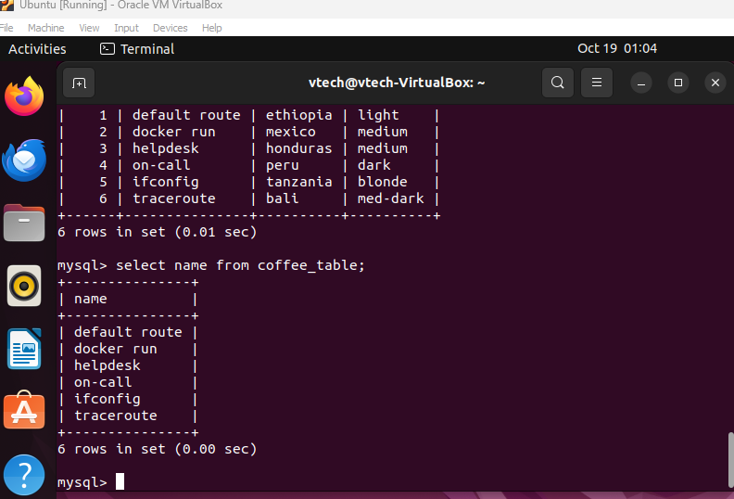
Specific Cololum
If I am to just select as specific from the Data base I used cmd select name from coffee_table;

